Slide 1

Software Architecture
DevOps Lifecycle

Slide 2

What is Software Architecture
When we build complex systems, we need to perform some level of design, to understand what it is we need to build.
That design happens at different 'levels':
  High Level Design
  Detailed Design

Slide 3
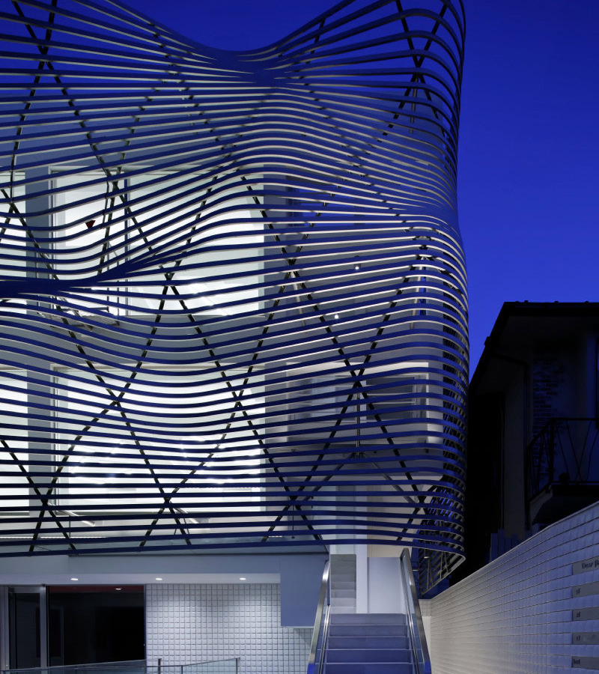
High Level Design
High Level Design includes:
  How to break down a system into different parts or components
  Ensuring the system is robust
  Ensuring the system can 'scale', e.g. when a lot of users are added
  Ensuring the system is secure
  Ensuring the system can grow, without breaking
This Photo by Unknown author is licensed under CC BY.

Slide 4
Detailed Design
Detailed design includes the following:
  Detail of functional behavior
  User Interface Design
  How code will be structured
  How code can be added without breaking existing code

Slide 5
Decoupling
An important concept in design is decoupling.
This principle attempts to ensure that a change in one part of a system has minimal impact to another part of the system.
We want to do this because:
  The less code that needs to be changed, the quicker and cheaper it is to add new functionality
  Making changes to existing code can change (break) the behaviour of any linked code.
  Therefore, changing code means retesting anything linked to the changed code.

Slide 6
Decoupling in Detailed Design
In detailed design and code we achieve this by:
  Ensuring we add new functionality without changing code we have already written.
  We write code that is general and can be reused in different use cases.
  We employ common 'patterns' of design that are very general in purpose.
  We minimise interaction between different parts of the code.

Slide 7
Decoupling in Architecture
Architecture is more commonly related to how our systems are split into different components.
To improve decoupling we:
  Minimise required interactions between components
  Make interactions between components well defined
  Reduce dependencies on details of each component (e.g. detailed logic, programming language etc).
  Allow components to operate independently of each other (so one component can still continue to perform its function even if another component is temporarily unavailable).

Slide 8

Architecture
Architecture relates to many of the aspect of high-level design.
The first decision to make about the architecture is how many components the system should have.
  In the past systems often had one main component that did most of the work. These are referred to as Monolithic systems.
  More recently complex systems are split into many components. There are many different approaches to doing this.

Slide 9
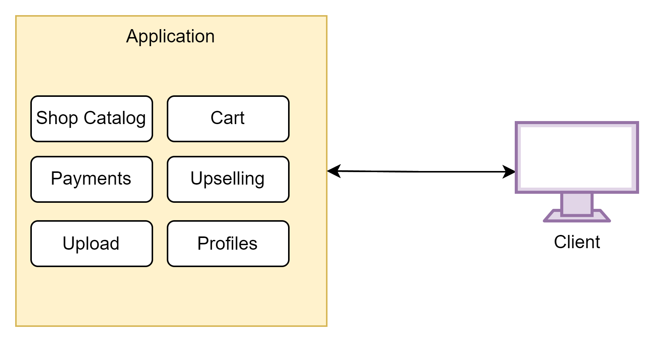
Monolithic Architecture
When software developers only consider functionality (not production), they usually build a monolithic systems – because it is easier to build a system in this way.
However, there are serious drawbacks to this approach when we try to run systems in production. Just some of the challenges are:
  They generally only have one or a small number of users.
  They are a single point of failure
  They are hard to scale (can only find more powerful hardware – limited)
  They are difficult to change – a change in one part may affect others
  It is difficult to deploy new releases – everything needs to change at the same time.

Slide 10
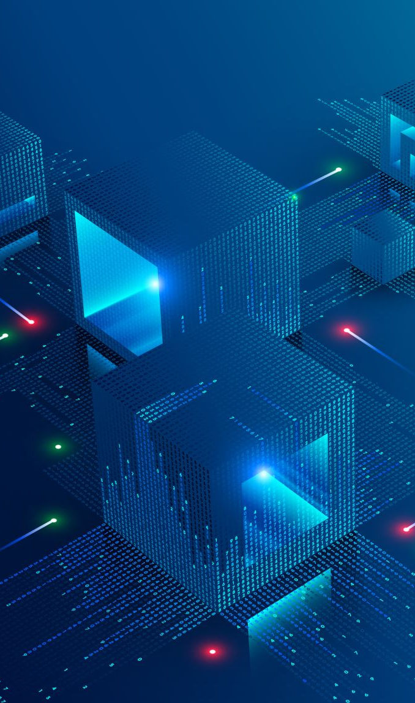
Three Tier Architecture
Monolithic architectures work best for a single user on a single computer (e.g. desktop or laptop).
But many systems rely on having multiple users operate interactively on the same set of data.
Many business applications are highly data driven. Managing data between multiple users can be complex:
  When one user is modifying data, other users cannot reliably access it.
  When there are lots of users - logic, security and resource usage becomes complex.

Slide 11
Three Tier Architecture
Because of these complexities it is very common practice to use specialist software for data management – a Database.
There are many different types of databases – Relational, NoSql, Graph, Vector, Data Warehouses, Data Lakes etc.
Where there are many users, we also need to split functionality between the user's view and the common data and functionality, so users can be operating on different tasks and have different views.

Slide 12
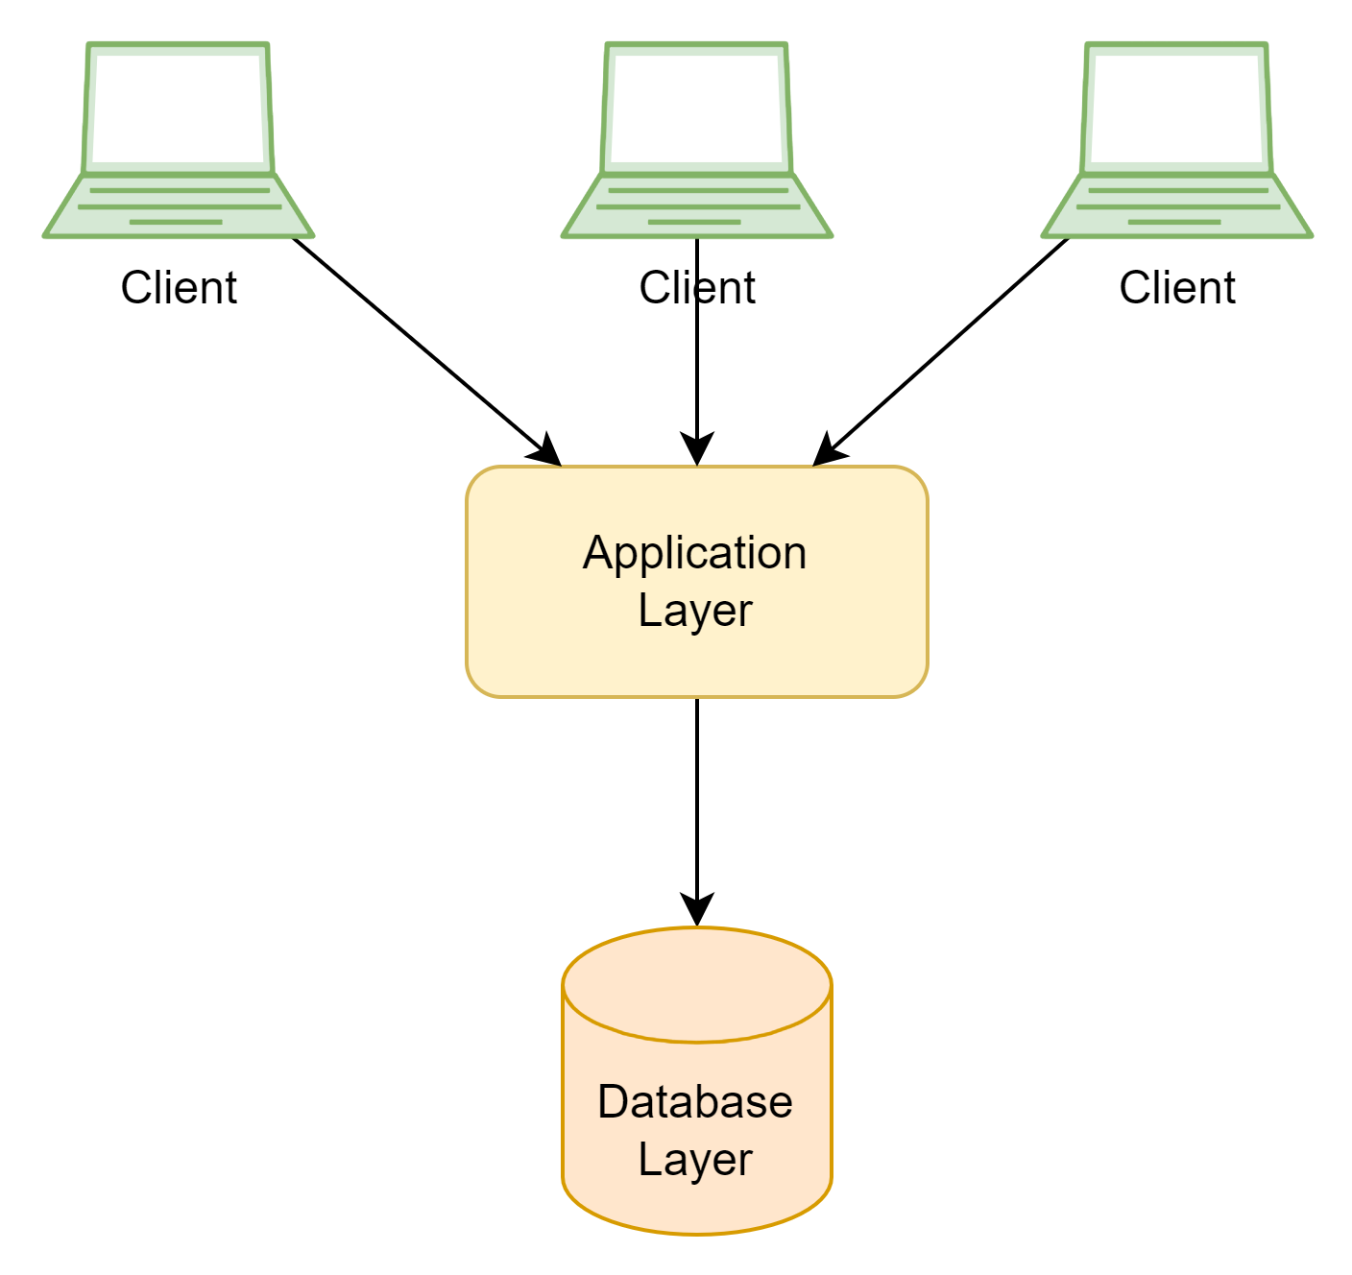
Three Tier Architecture
An early approach to architecture splits systems into three layers:
  Client: User View and logic
  Application: Common functionality
  Database: Stores and manages the data.

Slide 13
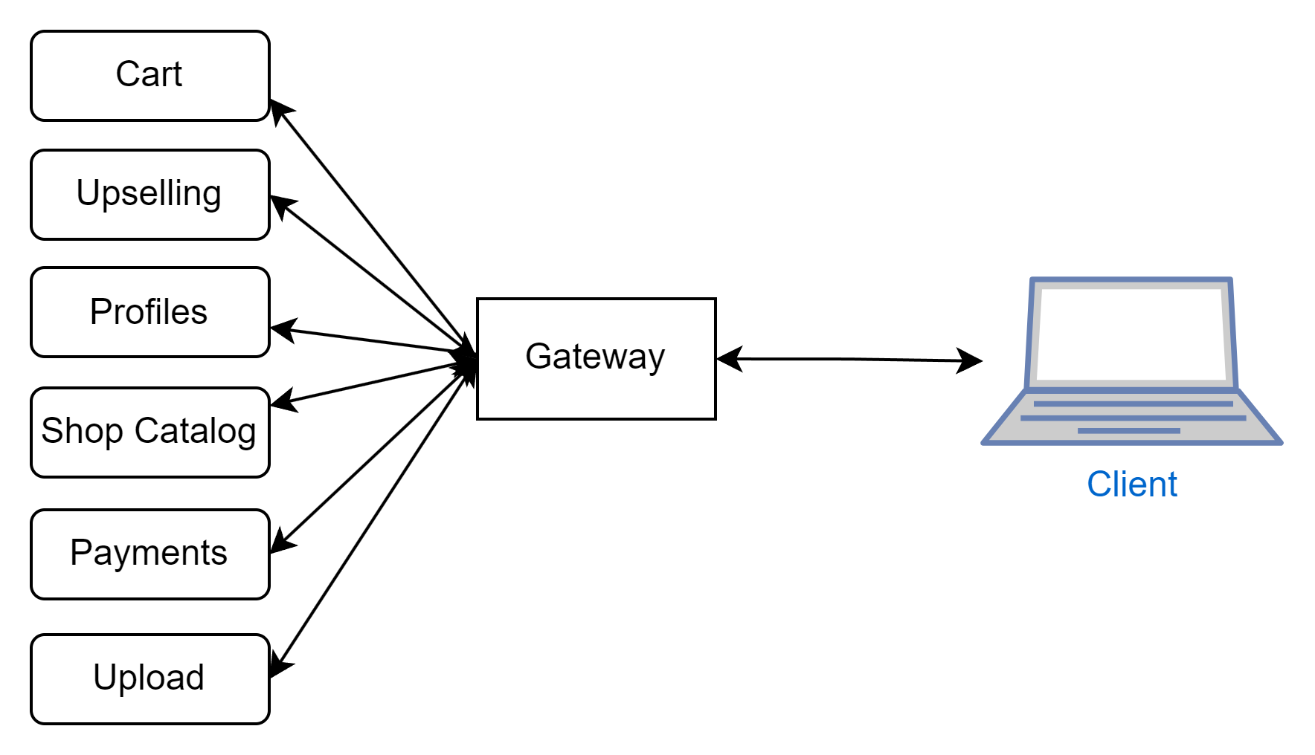
Distributed Architectures
Modern approach to architecture splits systems into multiple components.
This addresses many of the challenges of monolithic systems:
  Each component can be developed and deployed separately
  Components can usually be replicated and run on different servers/locations
  Components can be replicated as demand increases (on different servers)
The most common implementation of a distributed architecture is called Microservices. This architecture is used by companies such as Netflix, YouTube, Spotify, Microsoft and many more. Some platforms run hundreds of Microservices, distributed around the world.

Slide 14
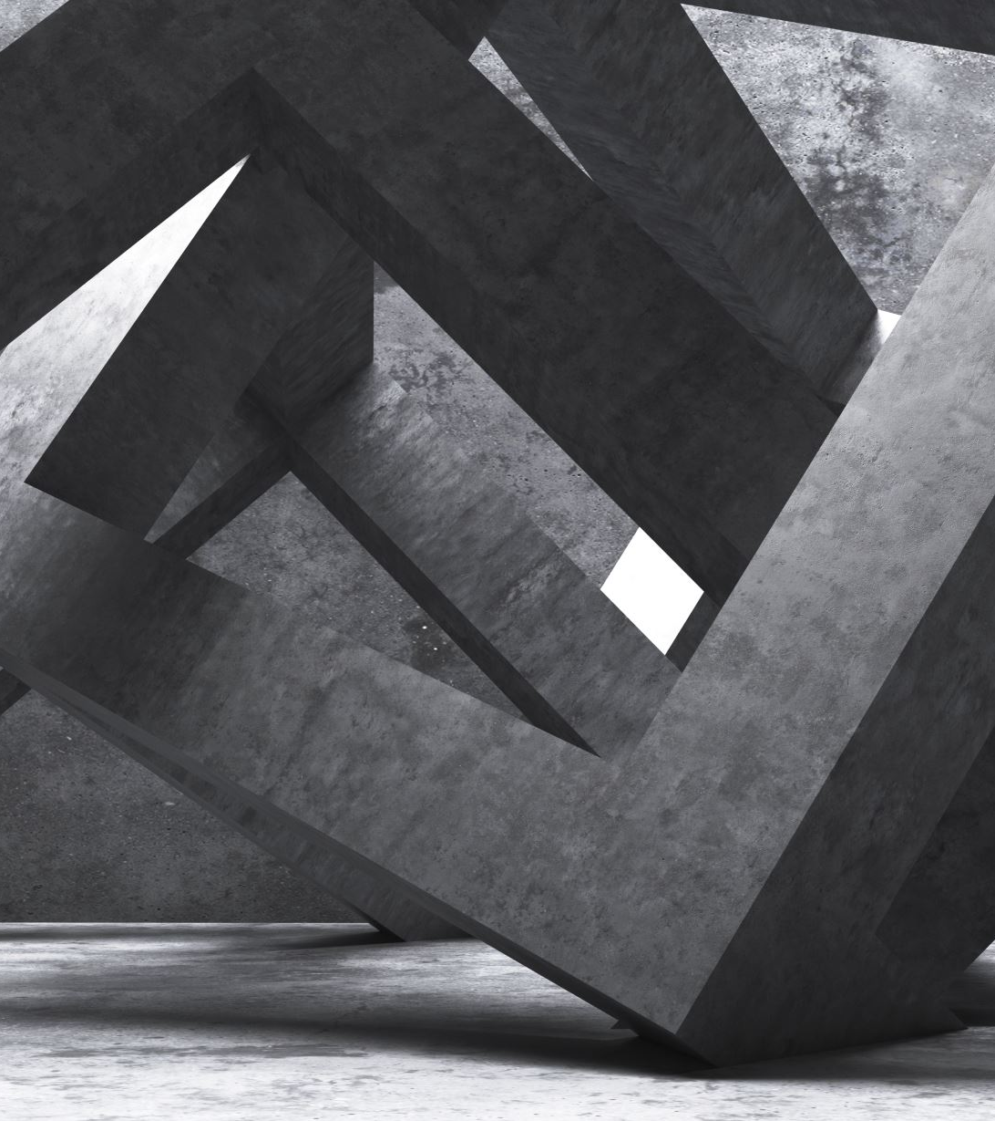
Challenges of Distributed Architecture
While distributed architectures, like Microservices address many of the weaknesses of a monolithic architecture, they also have some challenges:
  Concurrency and Inter-communications are more complex
  Deployment can be complex
  Monitoring and fault resolution can be complex.

Slide 15
Operational Concepts
Architecture is primarily about addressing the challenges faced in production, and we have a number of concepts and terms to describe different aspects of these considerations:
Reliability: Probability of performing a given function without failure
Scalability: Increasing load (e.g more users) does not impact performance
Resilience: Whether the system continues to be operational despite failures
High Availability: Percentage of time a system is available
Extensibility: Ease with which a system can expand, without impacting reliability
Security: Suseptability of system to external or internal malicious attacks

